Slide 1

CLIP: Checklist for Lung Injury Prevention
US Critical Illness and Injury Trials Group: Lung Injury Prevention Study Investigators (USCIITG–LIPS)

Slide 2
USCIITG-Lung Injury Prevention Group
A collaborative research network of 20 institutions for mechanistic studies and Acute Lung Injury prevention trials:
  Treatment options limited in
  Little research on Acute Lung Injury prevention
  Early (ED, OR) identification of patients at risk
  Multidisciplinary USCIIT group facilitates research in early stages of critical illness

Slide 3

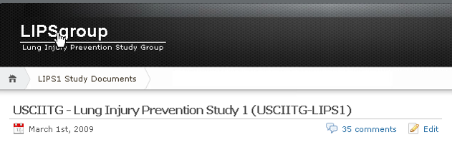
Mount Sinai School of Medicine
Temple University School of Medicine
The Johns Hopkins University
University of Medicine and Dentistry of New Jersey
Denver Health Medical Center
Hospital of the University of Pennsylvania
Brigham and Women's Hospital
Mayo Clinic Rochester
U of Michigan University Hospital
University of Washington, Harborview Medical Center
Parkland Health and Hospital System Dallas, Texas
University of Illinois at Chicago
Wake Forest University Health Sciences
Mayo Clinic Jacksonville
Bridgeport Hospital, Yale New Haven Health
Massachusetts General Hospital
Akdeniz University Hospital, Turkey
Beth Israel Deaconess Medical Center
Miami Valley Hospital
Emory University, Atlanta
Uludag University School of Medicine, Turkey
University of Missouri - Columbia
Lung Injury Prevention Study1:
  Develop and validate clinical prediction model to identify patients at high risk of developing Acute Lung Injury during their first 6 hours of hospital admission

Slide 4



Acute Lung Injury Pathophysiology
Initial Injury
Acid aspiration
Chemical
High tidal volume
Direct – Pneumonia
Mechanical
Biological
Indirect – SIRS, Abdomenal sepsis, TRALI
Membrane Injury
Acute Lung Injury
+
Inflammation
30 - 40%
Mortality
$$_
QALY

Slide 5
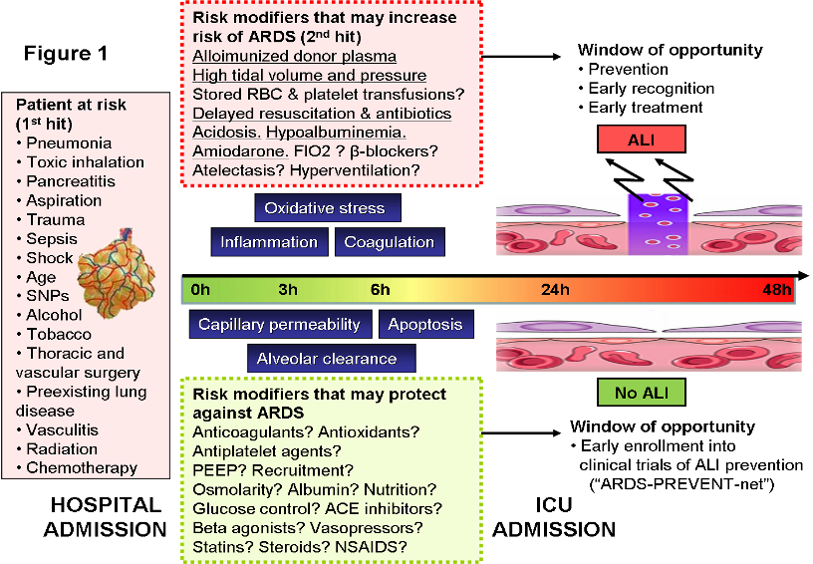
Pathophysiology of Acute Lung Injury- “Multiple Hit Hypothesis”
Risk modifiers that may ↑ risk of ALI (2nd hit):
High tidal volume, transfusion, delayed resuscitation, inappropriate antibiotics, aspiration, high FiO2,
Risk modifiers that may ↓ risk of ALI:
PEEP

Slide 6
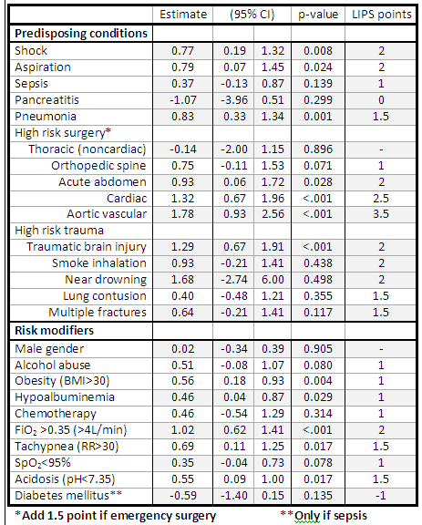
Lung Injury Prevention Study Score

Slide 7
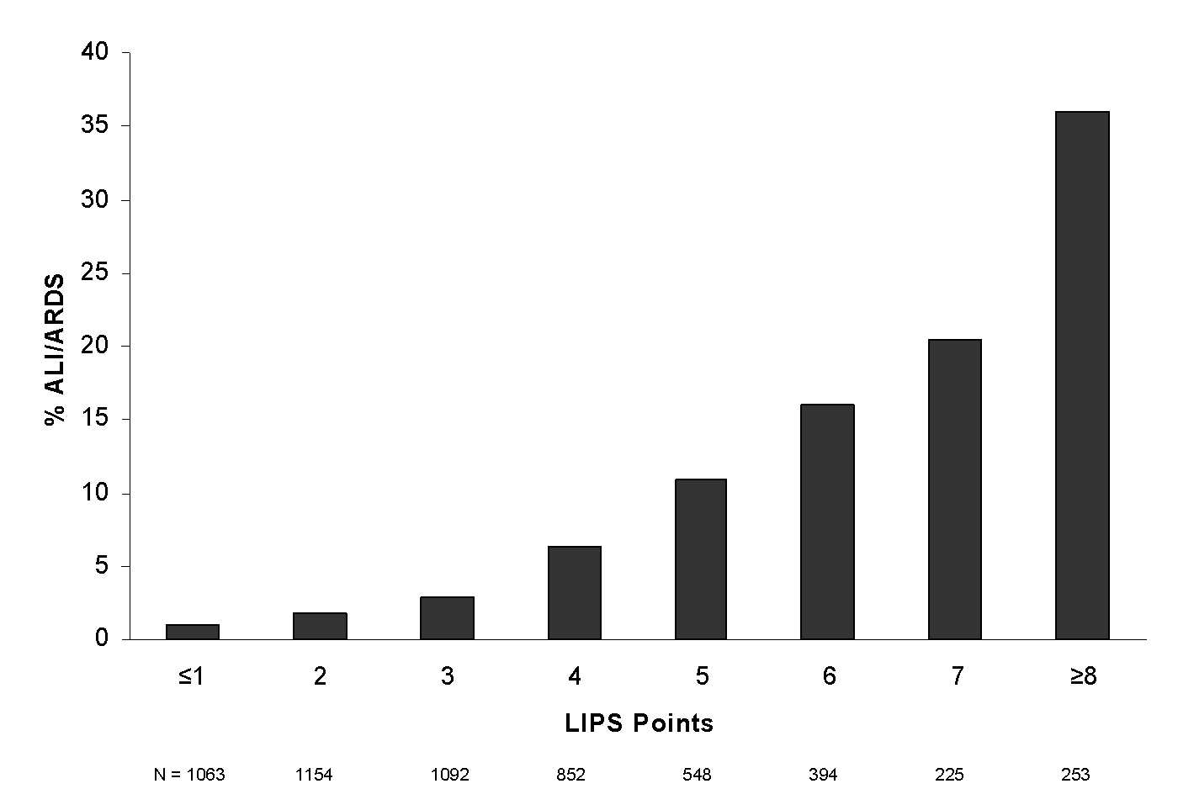
LIPS Score

Slide 8
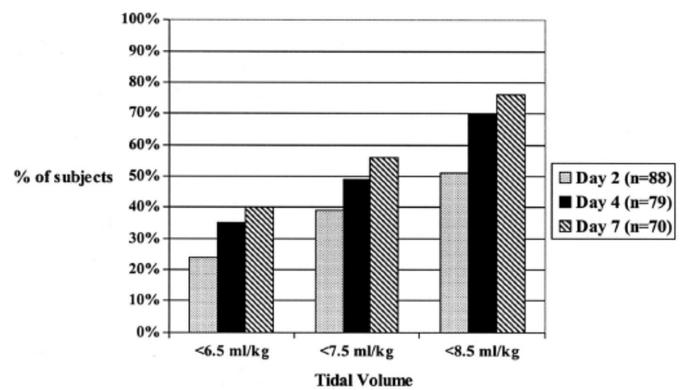
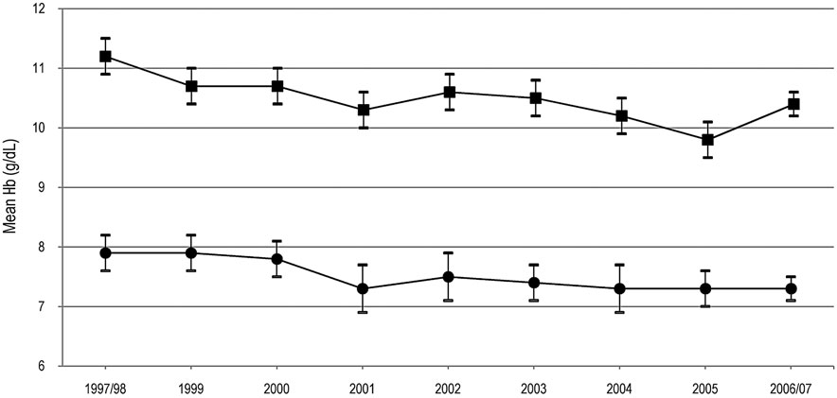
Many proven therapies are underutilized
Lower tidal volume in ALI/ARDS
Transfusion in ICU
Kalhan R, et al. CCM. 2006, Netzer G et. al. Transfusion. 2010
Notes:
Even in ARDS, low tidal volume ventilation is underutilized even when shown to save lives
Although transfusion in the ICU has decreased over time after the TRICC trial and median Hb in ICU patients have decreased over time, the most patients are still being transfused at a median Hb above 7.

Slide 9
Practice Variation Between Institutions and Within Institutions
Restrictive transfusion policies
  50% of ICU, 12.5% of ED, 6% of OR
Sepsis protocol
  69% of ICU, 6% of ED, 13% of OR
Structured handoffs on transfer
  35% between ED and ICU
  24% between ED and anesthesia
  36% between ED and surgical staff

Slide 10
CLIP Element | Clinically Supported practices | AHA grade
Adequate empiric antimicrobial treatment and source control | According to suspected site of infection, health care exposure, and immune suppression | Class I
Lung protective mechanical ventilation | Tidal volume <6-8 mL/kg predicted body weight and plateau pressure <25 cm H2O; PEEP≥5 cm H2O, minimize FIO2 (target O2sat 88-92% after early shock) | Class IIa
Aspiration precautions | Rapid sequence intubation supervised by experienced providers, elevated head of the bed, oral care with chlorhexidine, gastric acid neutralization | Class IIA-IIb
Early reassessment of noninvasive ventilation (to prevent delayed intubation) | Early reassessment of the work of breathing 30 minutes into the onset of noninvasive ventilation | Class IIb
Fluid management: - Early fluid administration in septic shock Limiting fluid overload after resuscitation | Resuscitation according to institutional protocol and IHI sepsis bundle Modified ARDSnet FACCT protocol after early shock (first 12 hours) | Class IIa Class IIa
Restrictive transfusion | Hemoglobin target >7 g/dL in the absence of acute bleeding and/or ischemia | Class IIa
Appropriate handoff of patients at risk | Structured handoff such as SBAR | Class IIa

Slide 11
Sample Patient
72 yo man with diabetes and CAD presents to the ED from acute rehab hospital at 4 AM with SOB.
  Initial work-up:
  Temperture 102 Heartrate 119 Respiratory
  Rate 32 Blood Pressure 85/65 Oxygen saturation 92% on RA
        WBC 18 ABG 66/36/7.36
        CXR with LLL infiltrate

Slide 12
Sample Patient
By 9 AM, the patient was awake, responsive:
  BP 92/69 on levophed at 3 mcg/min after only 3 liters of NS
  O2 sat 95% on 40% face mask

Slide 13
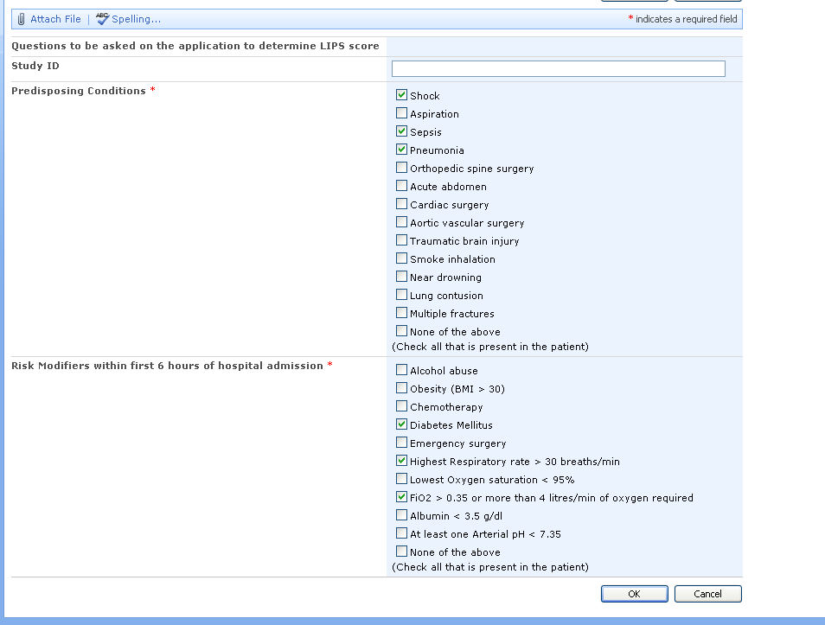


Slide 14
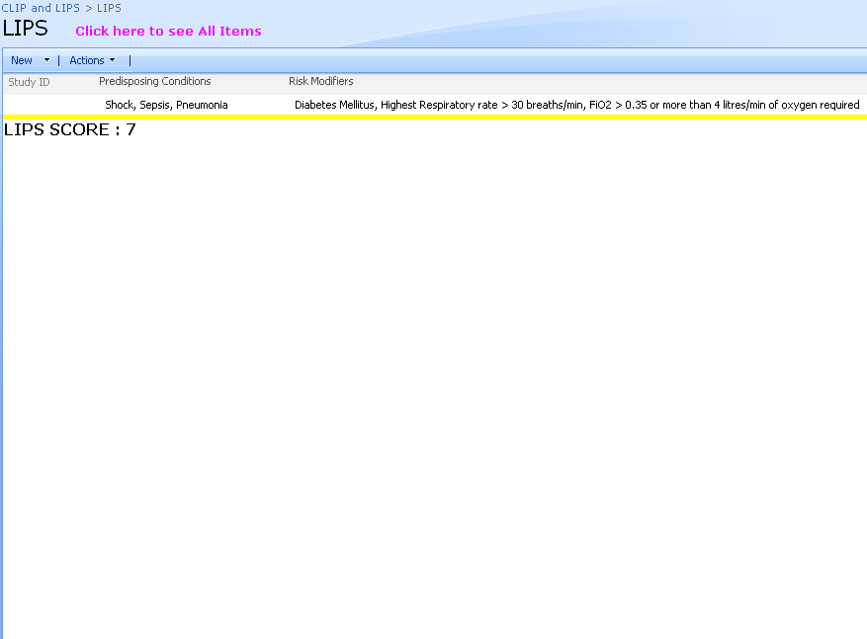
Lung Injury Prediction Score (LIPS) = 7
> 20% of pts with LIPS =7 develop ALI

Slide 15
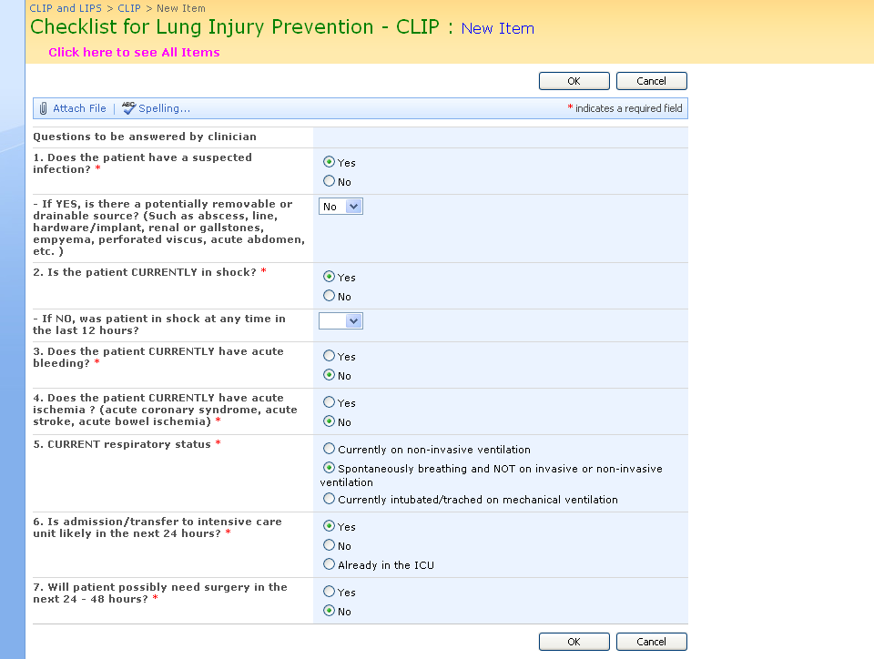

Slide 16
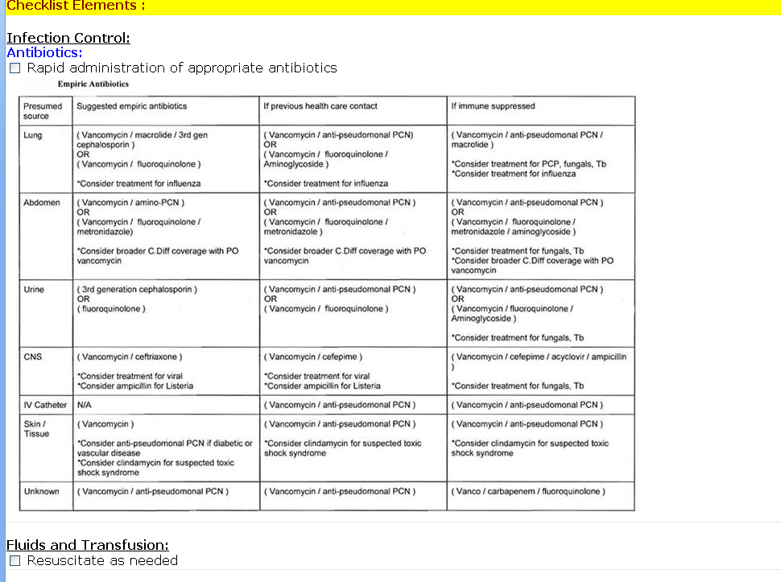

Slide 17
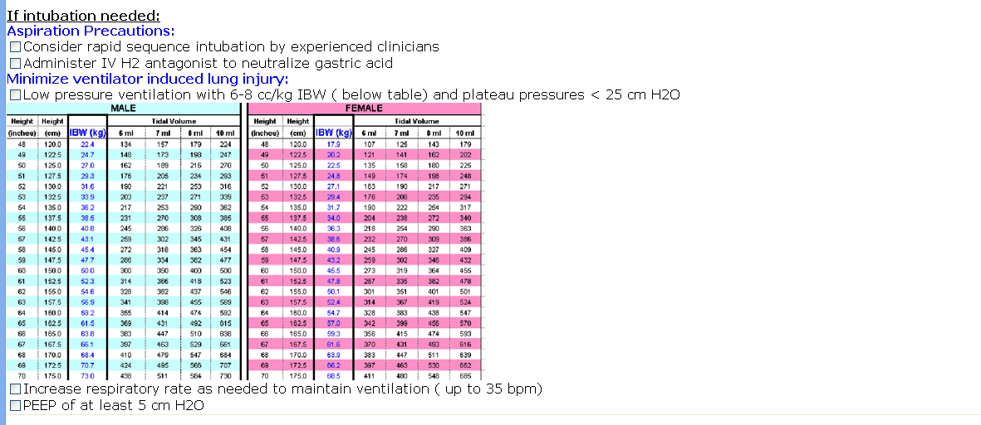
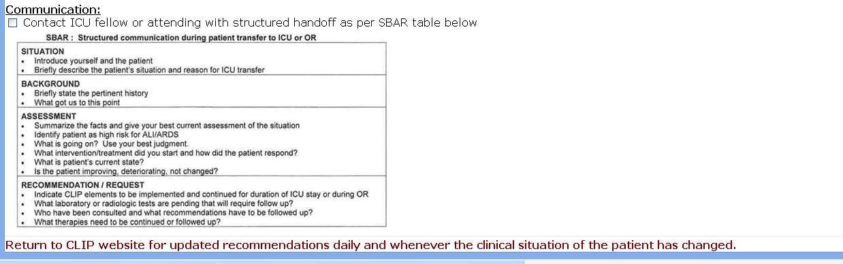

Slide 18
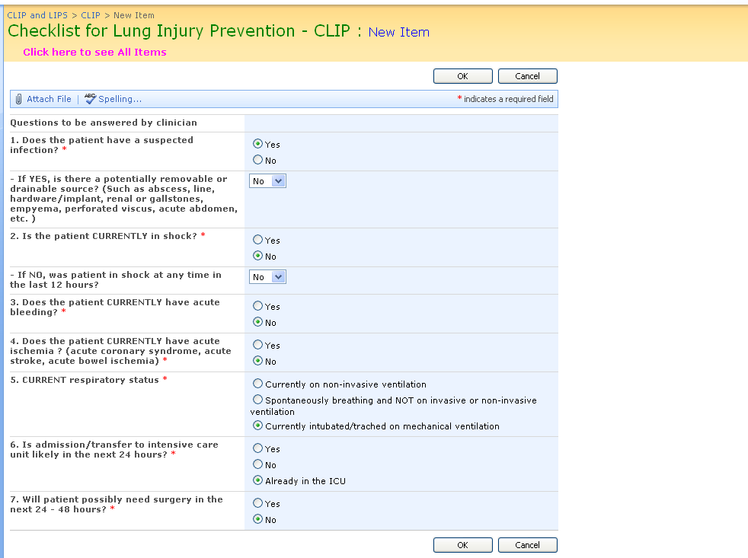

Slide 19
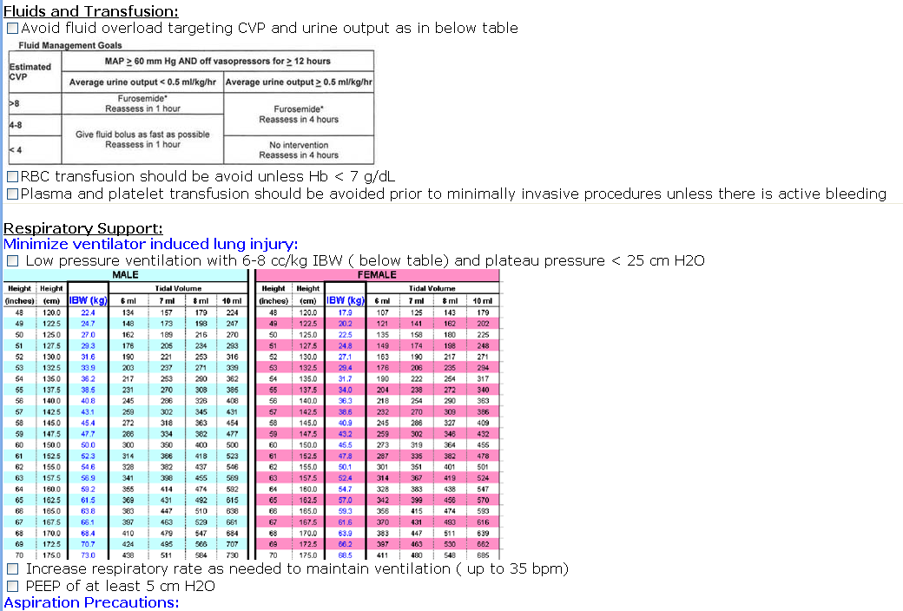
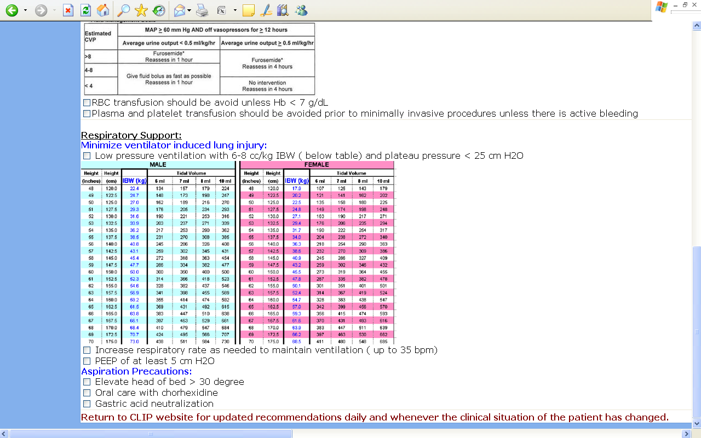

Slide 20
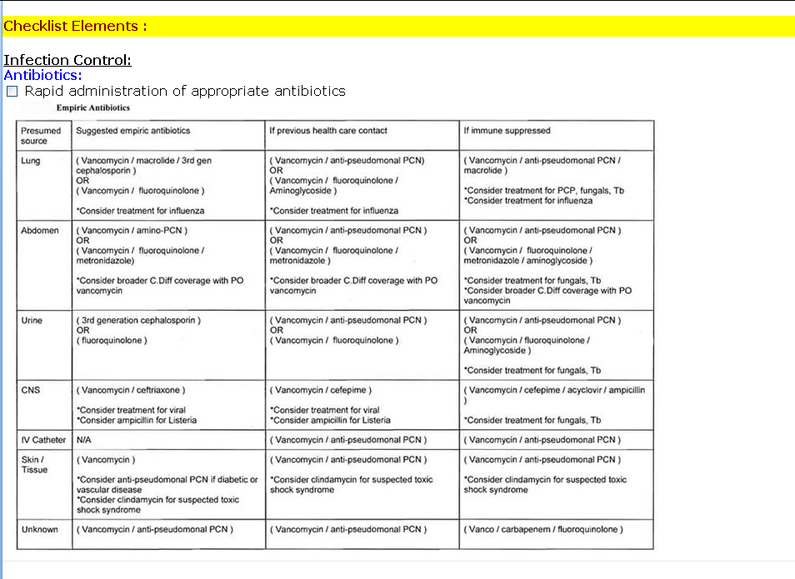
Notes:
Many of the CLIP elements were already implemented.

Slide 21
The Project
IPad/Iphone app to calculate the Lung Injury Prevention Score
Checklist of items for lung injury prevention
Usability Testing: Multicenter Group

Slide 22
Questions?
Raquel Bartz
Dept. of Anesthesiology
Email: raquel.bartz@duke.edu

